Slide 1
Old Photos Colorization Using CNNs and DNN
Yaqiu Liu,
Wudi Zheng,
Haoran Ding

Slide 2
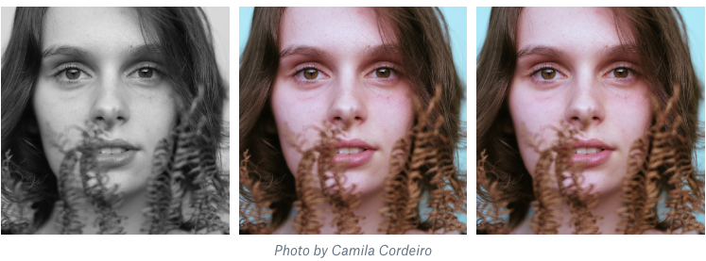
1. Topic:
Our topic is coloring the old photos with Neural Networks:
Grey Scale Input
Real Photo
Output Photo
Coloring Result

Slide 3
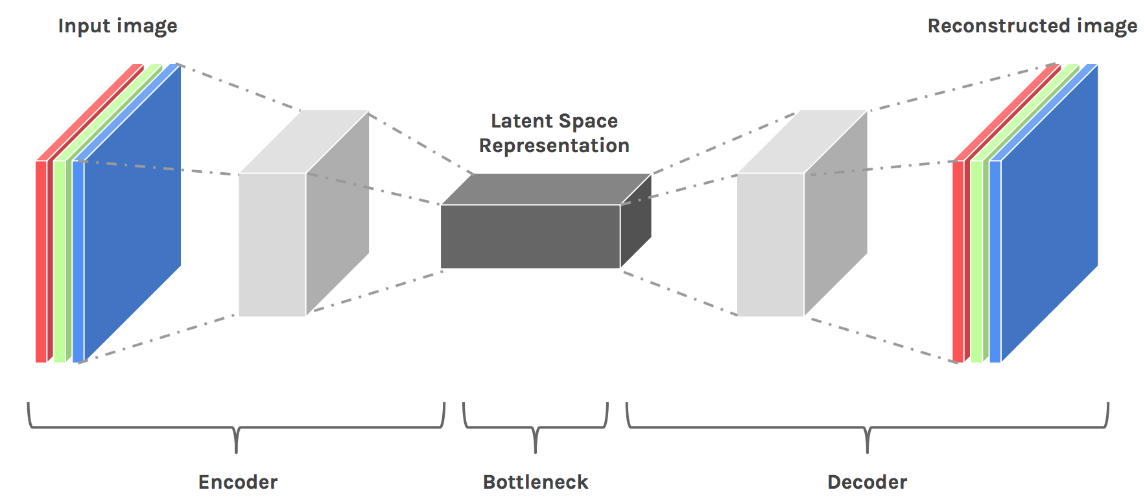
1. Topic:
The Neural Networks we choose is an encoder-decoder architecture:
An Overview of the Model Architecture

Slide 4
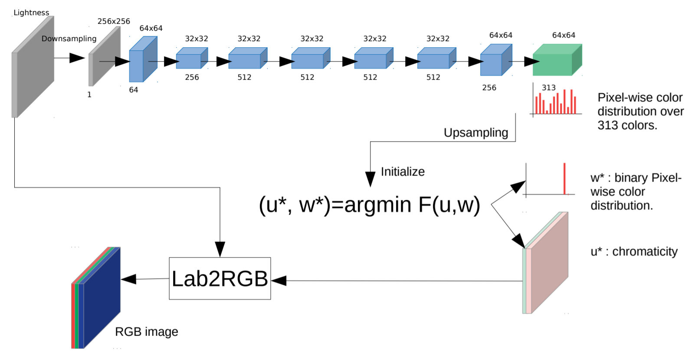
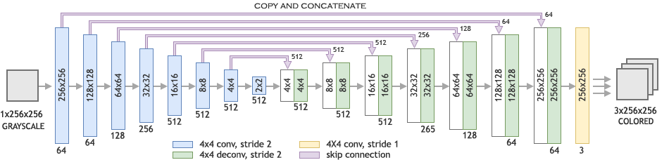
2. Related Works:
Existing colorization algorithms mainly consist of 3 categories:
Scribble-based approach
Reference-based approach
Fully automatic approach
CNN-based model
GAN-based model
Encoder-decoder model

Slide 5
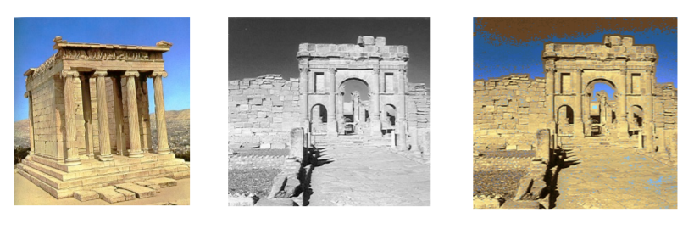
3. Advantages:
Comparing to the reference based approach, our approach can get a higher accuracy.
Referenced based Result

Slide 6
3. Advantages:
GAN based approach has some training problems like non-convergence, collapse problem.
Comparing to GAN based approach, our approach is more easier to train and we can utilize some high-level feature extraction using a pre-trained model to enhance the coloring process.

Slide 7
4. Innovation:
We will choose different feature extractor neural network.
We will design a new encoder-decoder architecture in order to get a better performance.
We will try to implement an image pre-processing on the input image.

Slide 8
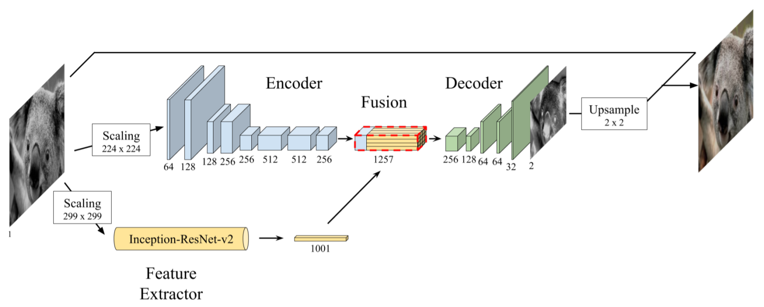
5. Model Architecture:
Baseline model:
Model Architecture

Slide 9
6. Training Approach:
Data source: ImageNet, Pascal VOC
Training method:
Train the net by reducing the Mean Square Error between the estimated pixel colors and their real value.
Test approach:
MSE
Real-perception

Slide 10
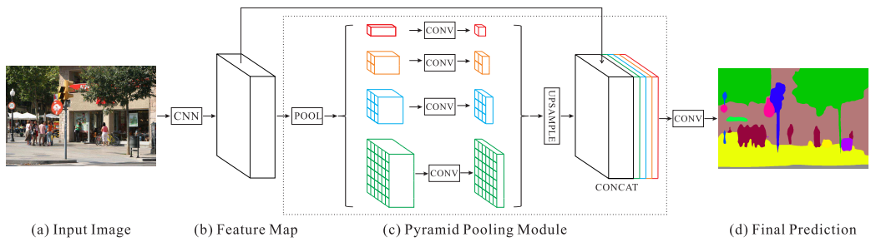
7. Another Try:
Modify the network to a Pyramid-like Network
Inspired by PSPNet
PSPNet

Slide 11
7. Another Try:
New network
(maybe)
2x2 encoder
Original encoder
Original image
with
Overlay-tile Strategy
Fusion layer
Decoder
Output
6x6 encoder
Feature extractor

Slide 12
The END
Thank You!

